Slide 1
Pure Water Demonstration and Artificial Intelligence Update
September 13, 2021
Notes:
COVER SLIDE
If you have a very long title, make it upper and lower case instead of all caps.

Slide 2
Pure Water Demonstration

Slide 3
Demonstration Project Goals
Goals
Demonstrate Pure Water
Evaluate Full-Scale Design Parameters
Train Operations Staff
Engage Stakeholders

Slide 4
Pure Water Performance
Microbiological (Pathogens)
12/10/10 Log Reduction
Process | Virus | Protozoa
Microfiltration/ Ultrafiltration | 2.5+ | 4+
Reverse Osmosis | 2+ | 2+
Ultraviolet Light with Advanced Oxidation | 6 | 6
Free Chlorination | 5 | 0
Totals | 15.5+ | 12+

Slide 5
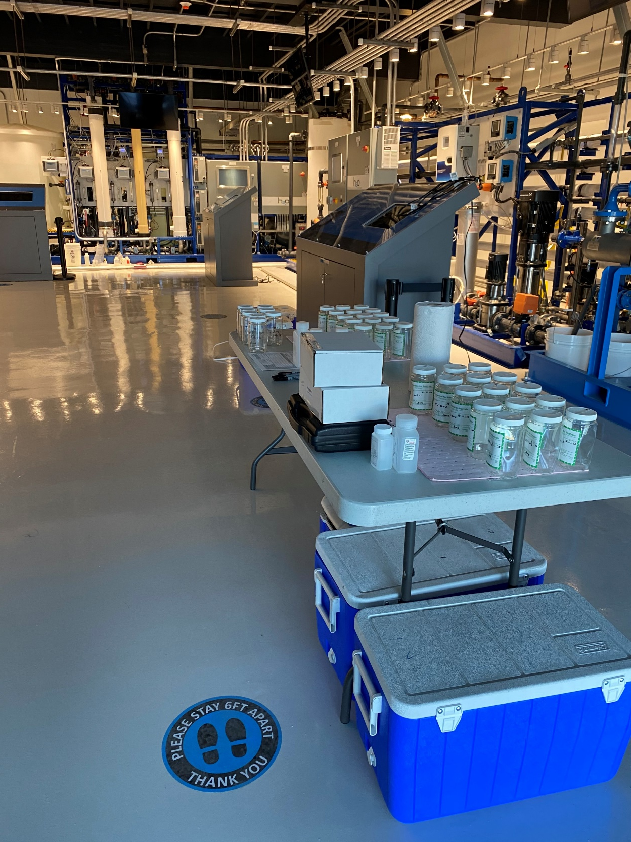
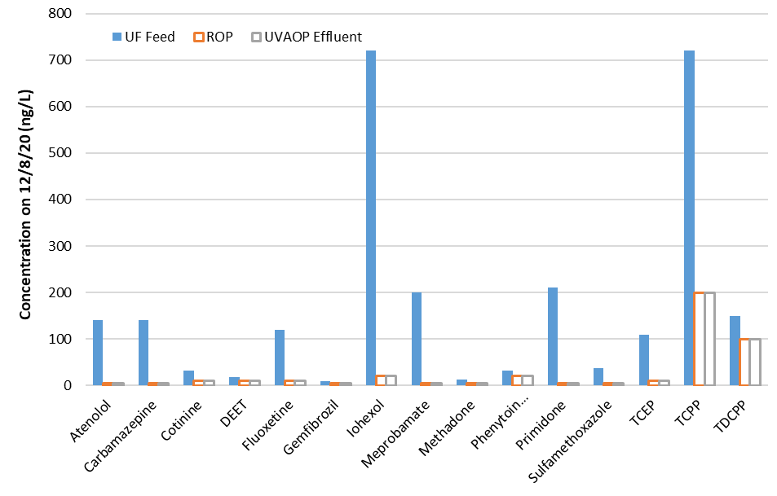
Pure Water Performance
Chemicals
¼ Sampling for regulated pollutants, zero exceedances of MCLs
Parameter | Feed | Purified Water
Total Dissolved Solids (TDS) | ~750 mg/L | ~20 mg/L
Total Organic Carbon (TOC) | 6 to 7 mg/L | 0.06 to 0.08 mg/L
Extensive sampling of CECs, zero exceedances of health levels

Slide 6
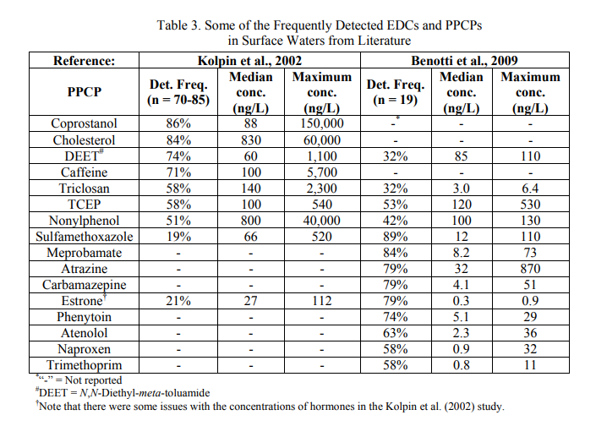
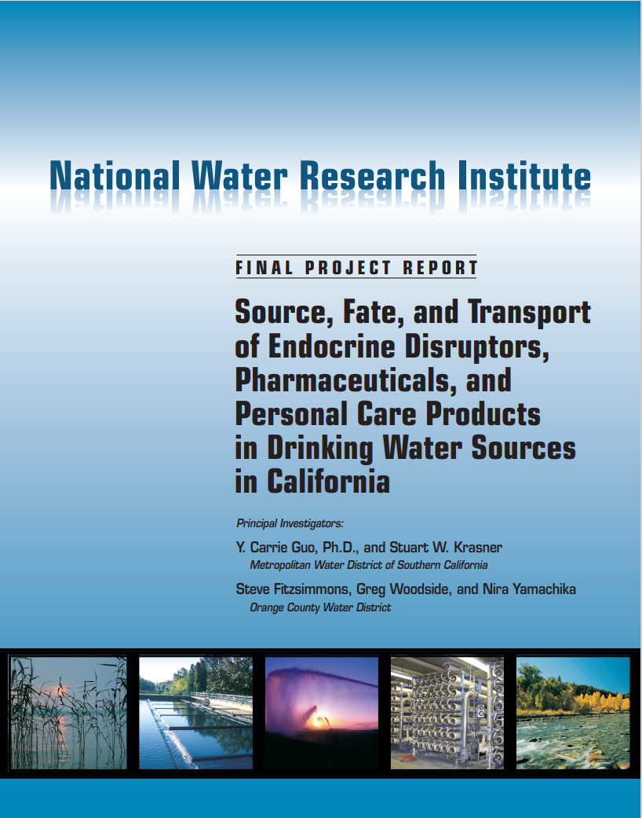
Pure Water Comparisons
Note: a ng/L is a very low concentration and these detections to not represent a public health risk
Drinking Water Supplies

Slide 7
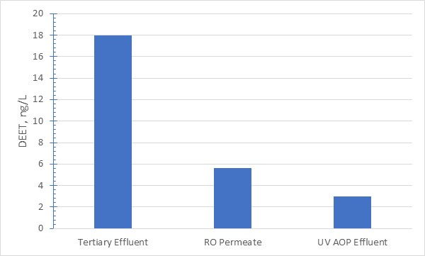
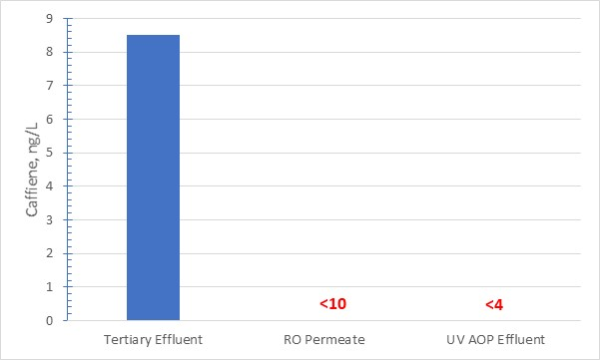
Pure Water Comparisons
Pure Water DEMO
Drinking Water Supplies

Slide 8
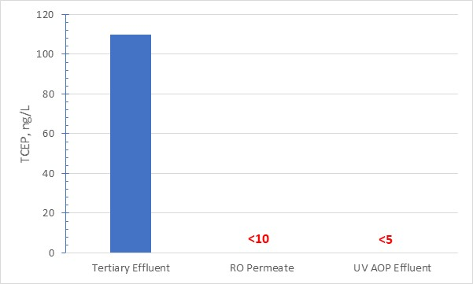
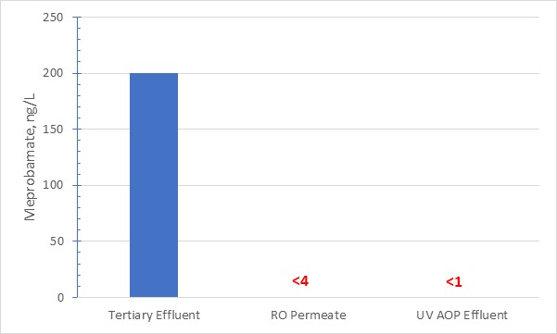
Pure Water Comparisons
Pure Water DEMO
Drinking Water Supplies

Slide 9
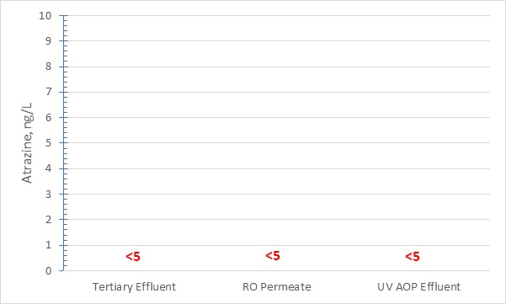
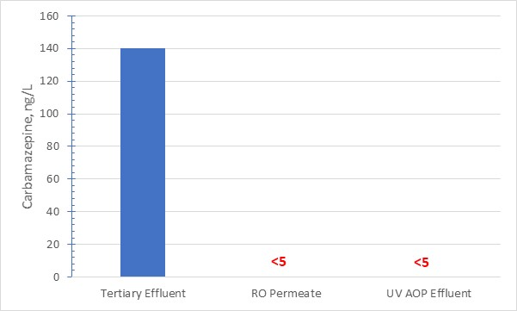
Pure Water Comparisons
Pure Water DEMO
Drinking Water Supplies

Slide 10

Pure Water Comparisons
Pure Water DEMO
Drinking Water Supplies

Slide 11
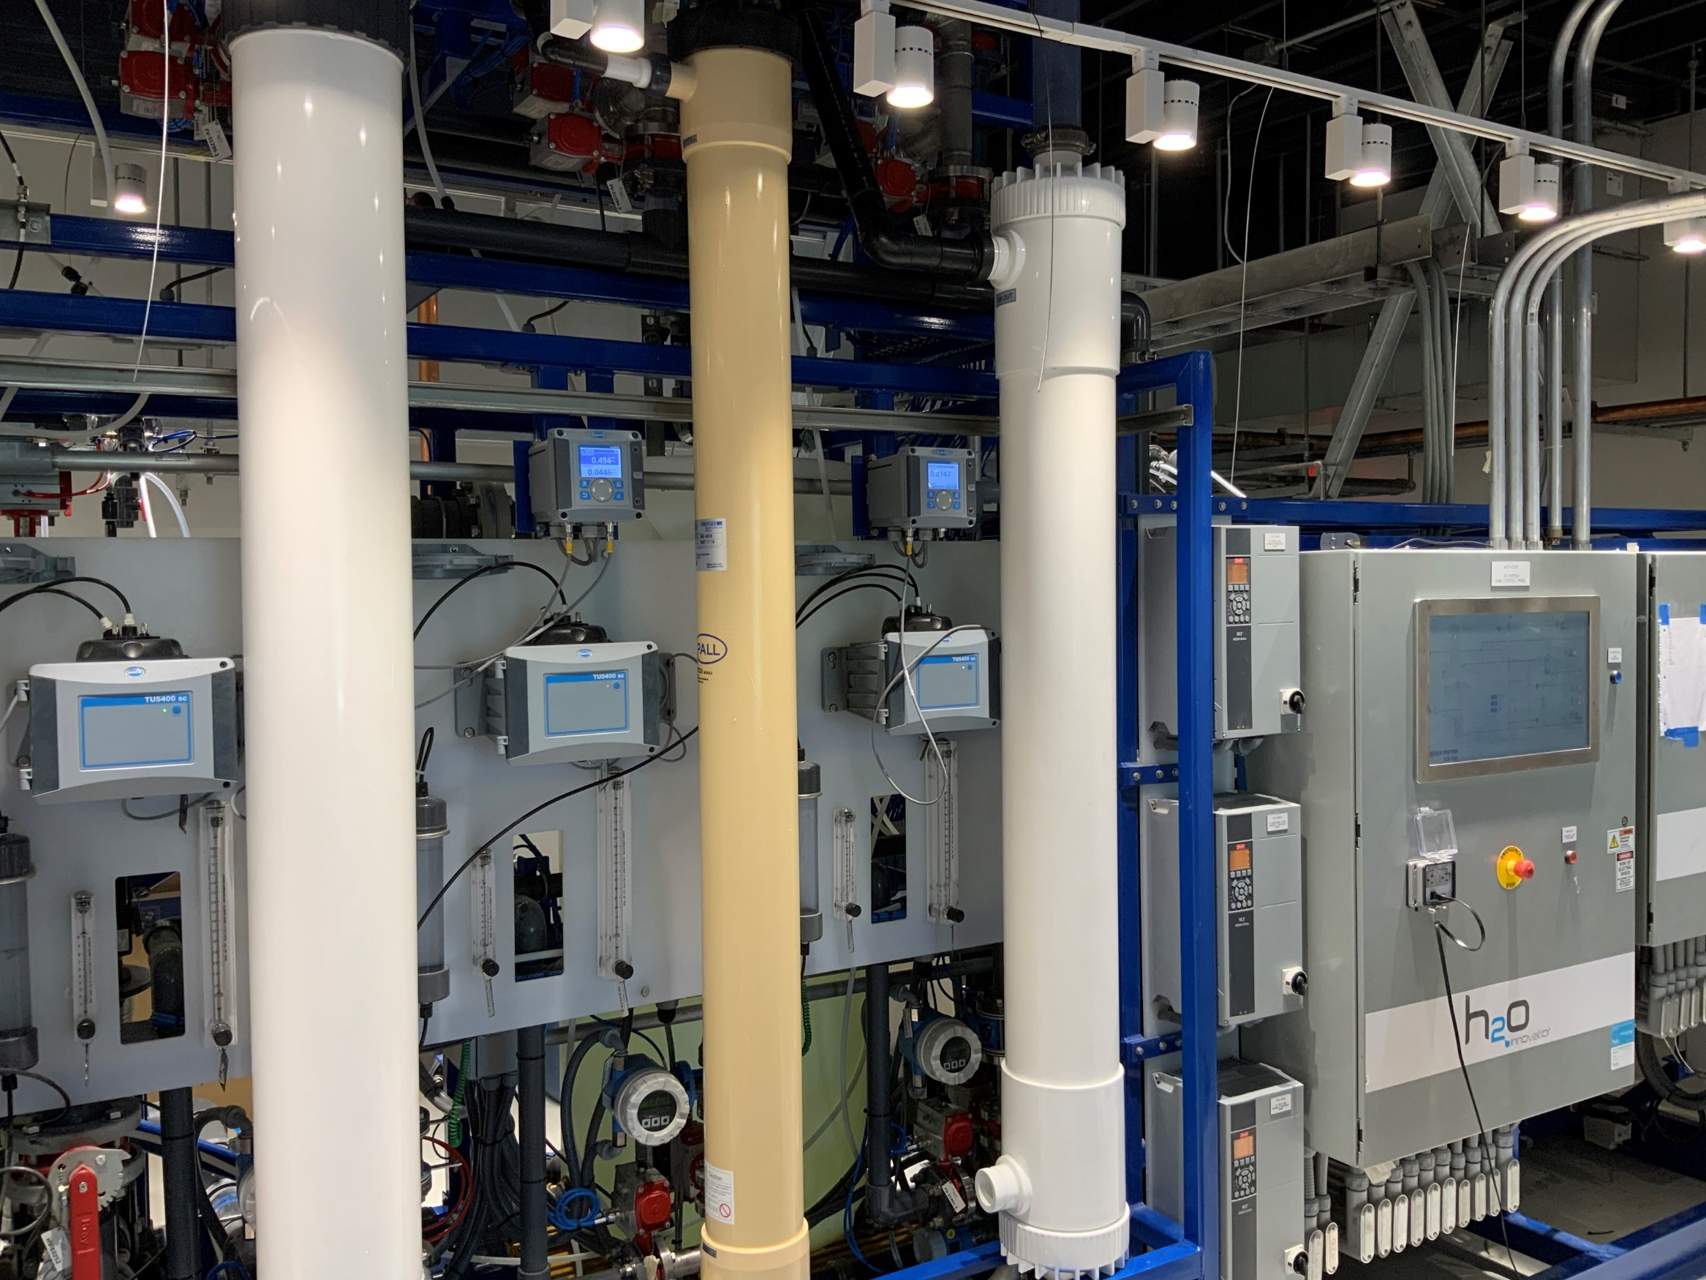
Full Scale Design
3 Suppliers Fully Vetted
Future “Flux” of 40 to 50 gfd, much greater than conventional 25 gfd designs
$Ms saved due to higher Flux

Slide 12

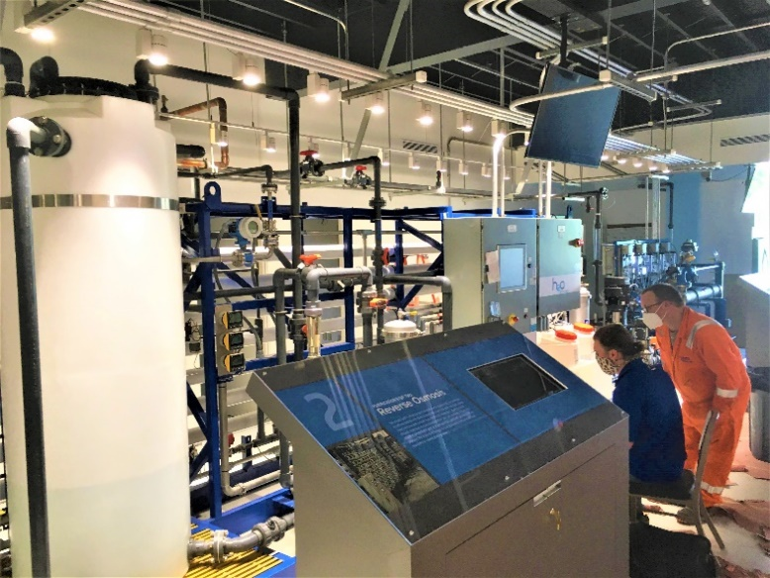
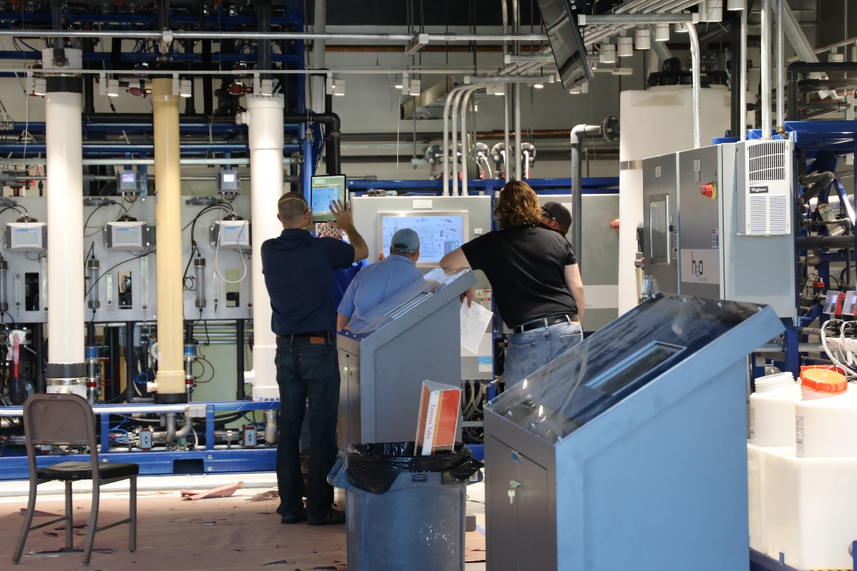
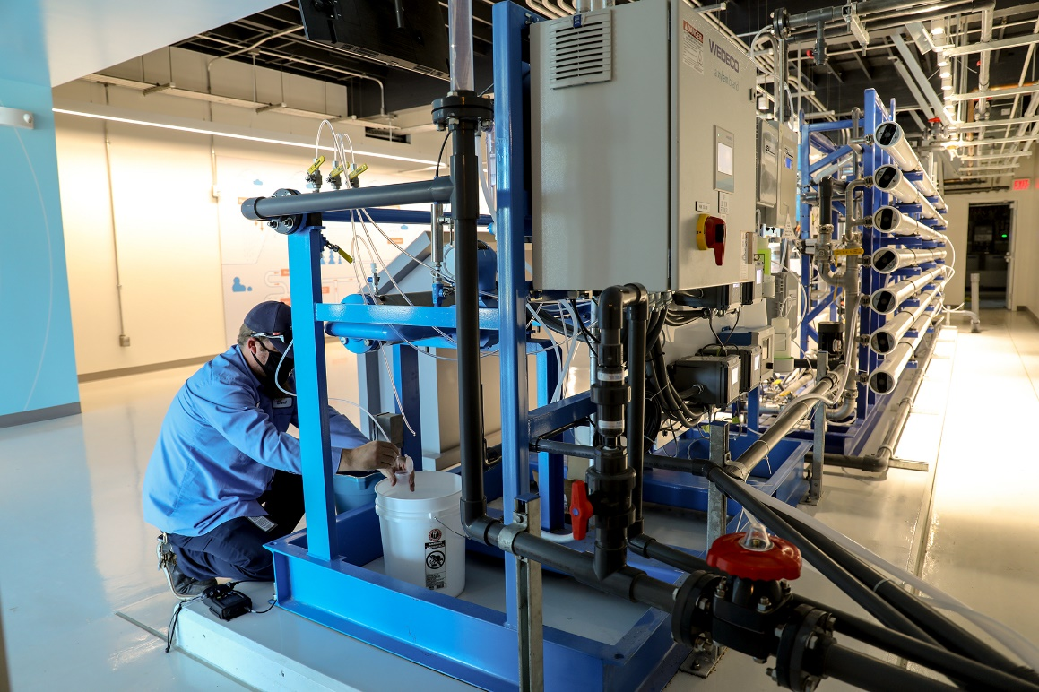
Operator Training
Conventional Ops Certifications Not Enough!
AWTO Required for Potable Reuse

Slide 13
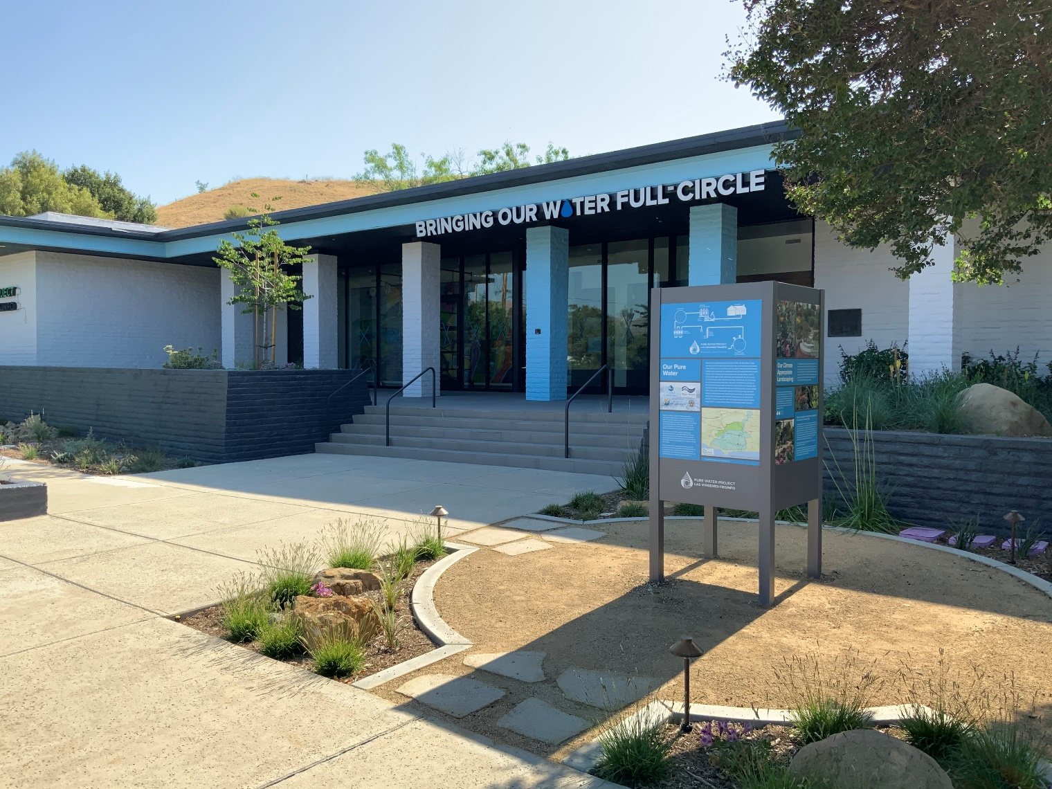
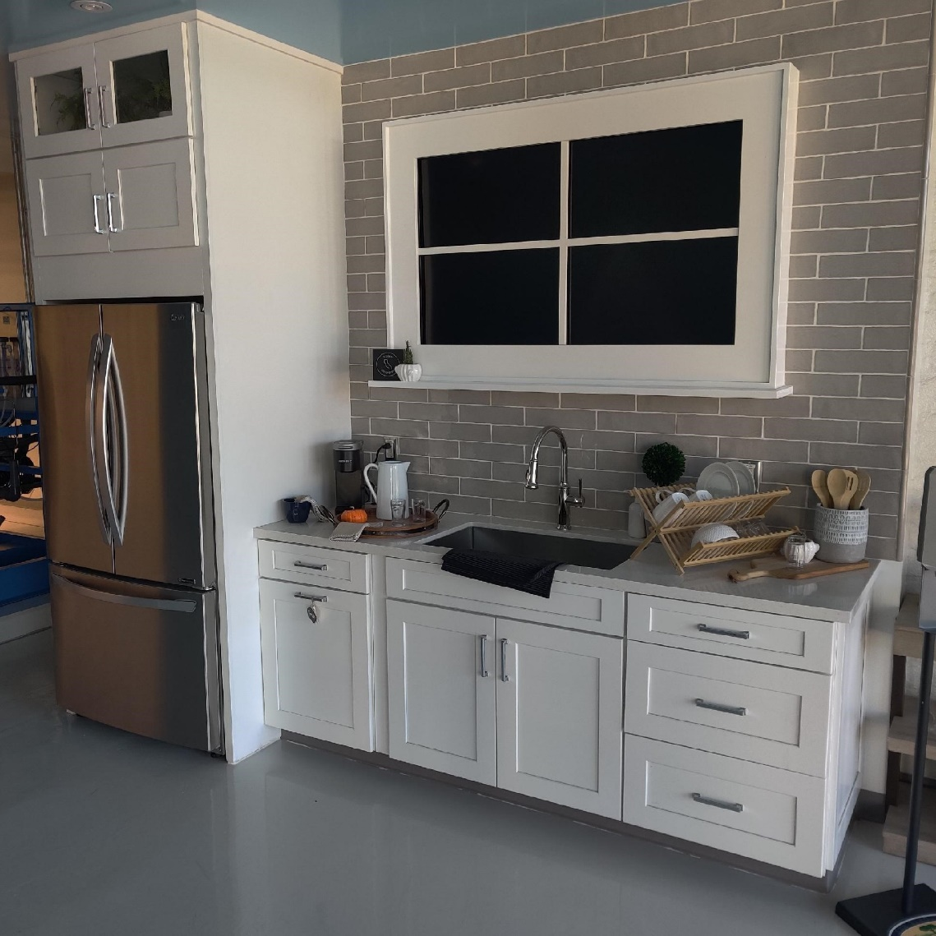
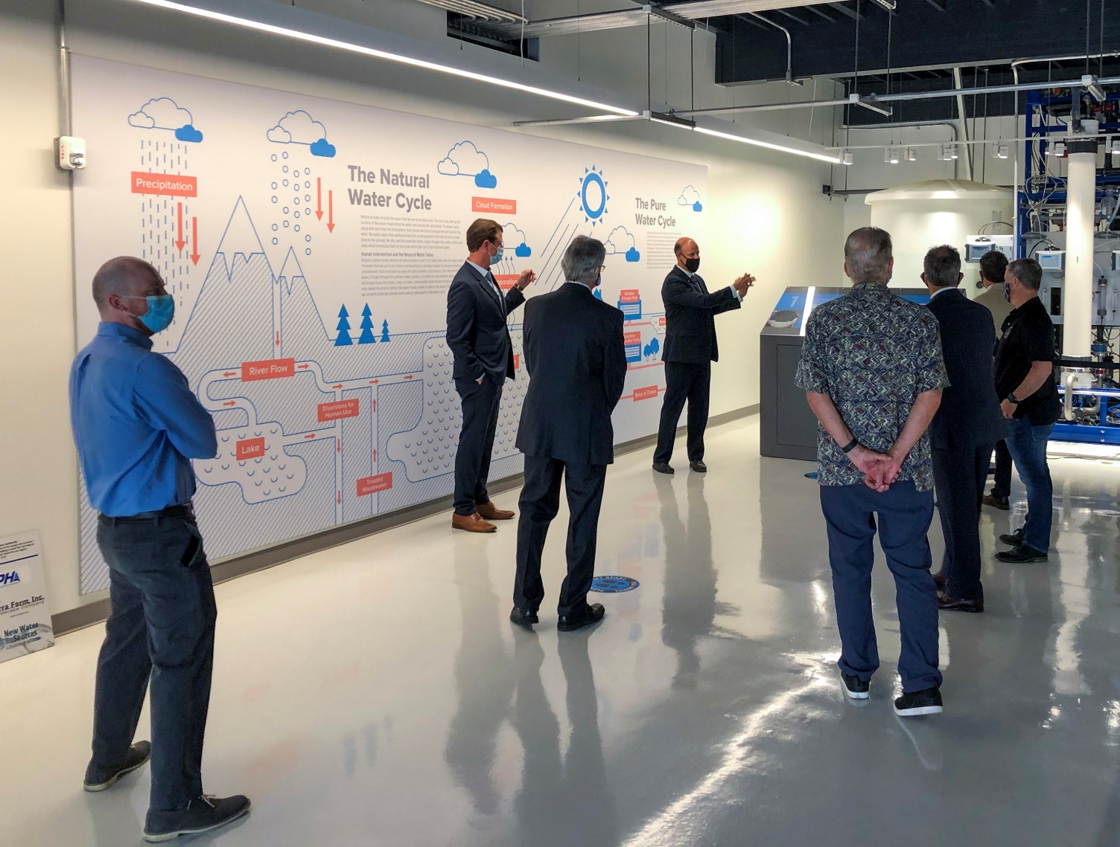
Engage Stakeholders

Slide 14
Artificial Intelligence/Machine Learning

Slide 15








Broad Collaboration for Project Success
Project Participants
Funding Partners

Slide 16

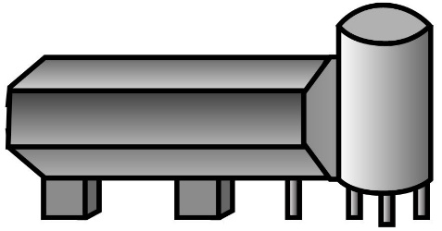

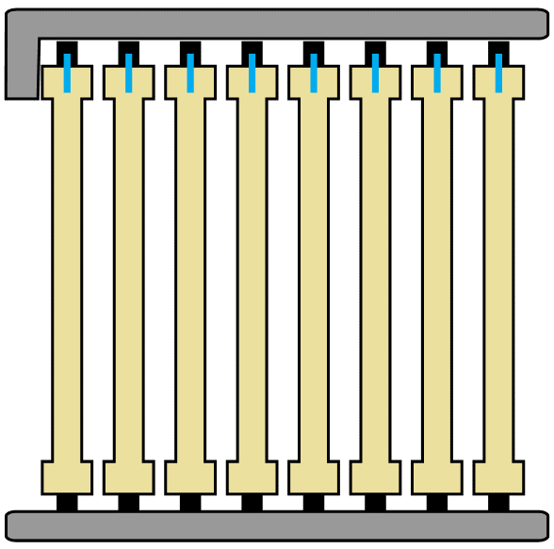
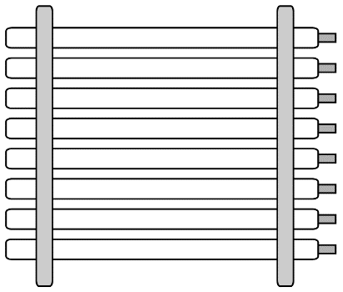



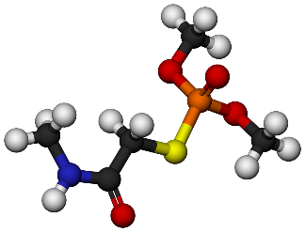

Wholistic Approach to Energy Use and Water Quality
Primary Treatment
Biological Secondary Treatment
UV Disinfection
Ultrafiltration
Reverse Osmosis
Notes:
Potable water reuse, from raw wastewater to purified water is a multi barrier process for chemical and pathogen removal
The entire treatment train is energy and operations intensive, going to advanced treatment more than doubles the energy use and operations staff needs of a conventional WWTP
Within these systems, there are areas to optimize in terms of energy use and operational efforts, all WHILE MAINTAINING WATER QULAITY.

Slide 17
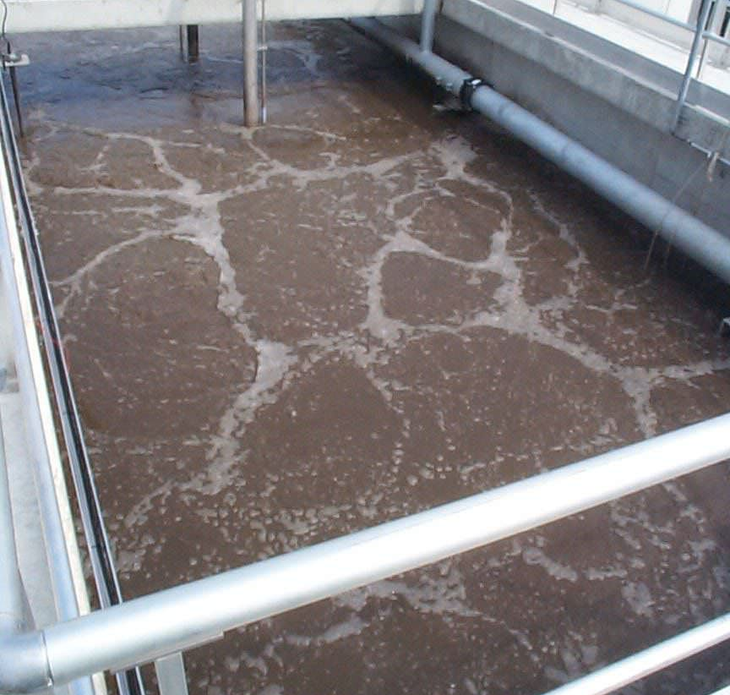
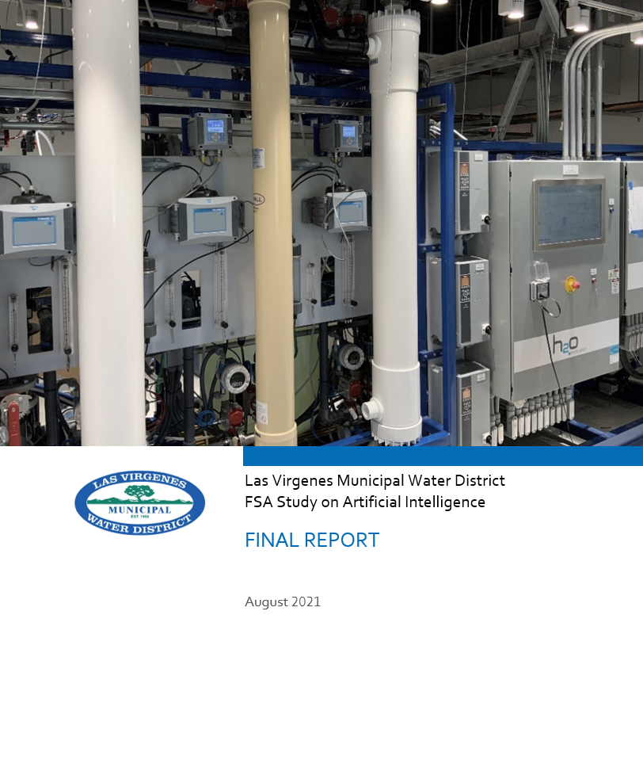

First Work Completed as Part of MWD FSA Grant

Slide 18
Subsequent and Extensive Analysis Moving Ahead

Slide 19
Reducing Energy Use at Tapia!
Nutrients and Performance
Airflow
Power

Slide 20
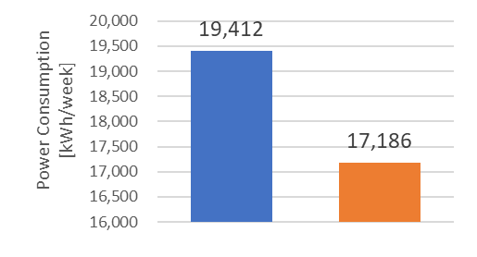
AI/ML Predicts 10% Energy Savings
Data Driven Model Optimization (DDMO)
Accurately Predicts Performance
Energy Savings!

Slide 21

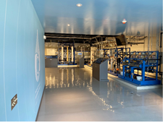

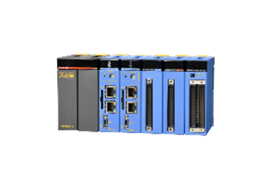





We have the Technology…but how do best communicate it?
Operation & Data upload at real-time
OPTimization Interface and Control System (OPTICS)
Full-scale OPTICS Trials Now Underway
Real time analysis of data
Daily Reporting of Operational and Data Modifications
Notes:
OPTICS development, real time transfer of data, AI analysis, recommendations, OPTICS interface…while leaving the key decisions in the hands of operations staff. This is not Autonomous Operation.

Slide 22
Thank You!

